Slide 1

Scope of Disclosure | TSIP Team
Confidential period | Indefinite
Head of information owner section | Training Division Head
Handling restriction | “No Copying” , “No Printing” “No transferring”, “No re-disclosure” “No circulation” , “Do not duplicate”
Classes : Part 2

Slide 2



UML 2.5 discussions have been known to cause or induce sleep among participants.
Necessary precautions to prevent injuries due to participants falling off chairs ,resulting from UML-induced stupor is highly advised ☺
Please do not fall off the chair !

Slide 3



Why We Model
Use Cases
Classes Part 1
Classes Part 2
Sequences
Activities
State Machines
Packages
Prep

Slide 4
Simple Classifiers

Slide 5
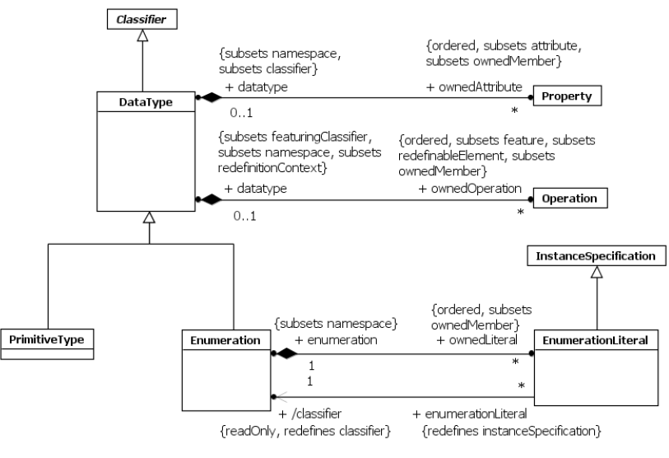
Simple Classifiers : Data Types
Simple Classifiers : classifiers that do not have complex internal structure.
#1. Data Types :
kind of Simple Classifier
model Types whose instances are distinguished only by their value
All instances of a DataType with the same value are considered to be equal instances.

Slide 6
Simple Classifiers : Data Types
If a DataType has attributes (i.e., Properties owned by it and in its namespace) it is called a structured DataType. Instances of a structured DataType are considered to be equal if and only if the structure is the same and the values of the corresponding attributes are equal
A PrimitiveType defines a predefined DataType, without any substructure
Enumeration is a kind of DataType. Each value of an Enumeration corresponds to one of its user-defined EnumerationLiterals
As a specialization of Classifier, Enumerations can participate in generalization relationships
An Enumeration that specializes another may define new EnumerationLiterals that are not defined in the generalizing Enumeration => the set of applicable literals comprises inherited literals plus locally-defined ones.
An EnumerationLiteral defines an element of the run-time extension of an Enumeration.
Values corresponding to EnumerationLiterals are immutable and may be compared for equality
An EnumerationLiteral has a name that shall be used to identify it within its Enumeration

Slide 7

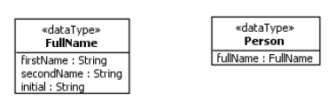
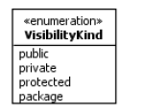

Slide 8
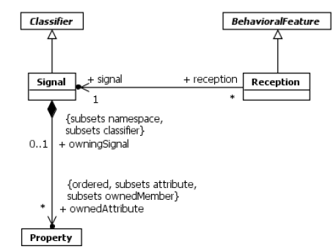
Simple Classifiers : Signals/Receptions
Signals and Receptions are used to model asynchronous communication between objects .

Slide 9
Simple Classifiers : Signals/Receptions
Signal is a specification of a kind of communication between objects in which a reaction is asynchronously triggered in the receiver without a reply
The receiving object handles signals
Signals data carried by the communication are represented as attributes of the Signal
A Signal is defined independently of the Classifiers handling it.
The sender of a Signal will not block waiting for a reply but continue execution immediately
By declaring a Reception associated to a given Signal, a Classifier specifies that its instances will be able to receive that Signal, or a subtype thereof, and will respond to it with the designated Behavior.
A Reception specifies that its owning Class or Interface is prepared to react to the receipt of a Signal
A Reception matches a Signal if the received Signal is a specialization of the Reception’s signal.
The name of the Reception is the same as the name of the Signal.
A Reception may only have in Parameters that match the attributes of the Signal by name, type, and multiplicity

Slide 10
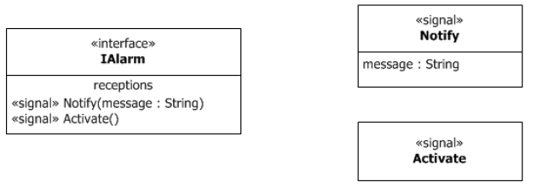
Simple Classifiers : Signals/Receptions

Slide 11
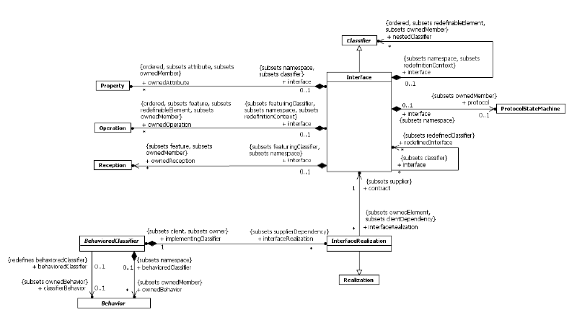
Simple Classifiers : Interfaces
Interfaces declare coherent services that are implemented by BehavioredClassifiers that implement the Interfaces via InterfaceRealizations.

Slide 12
Simple Classifiers : Interfaces
An Interface is a kind of Classifier that represents a declaration of a set of public Features and obligations that together constitute a coherent service.
An Interface specifies a contract; any instance of a Classifier that realizes the Interface shall fulfill that contract.
Protocol specifications could impose ordering restrictions on interactions through the Interface
Interfaces may not be instantiated
Interface specification is implemented or realized by a BehavioredClassifier, which means that the BehavioredClassifier presents a public facade that conforms to the Interface specification
A given BehavioredClassifier may implement more than one Interface and that an Interface may be implemented by a number of different BehavioredClassifiers.
Interfaces provide a way to partition and characterize groups of public Features and obligations that realizing BehavioredClassifiers shall possess.
Interface does not specify how it is to be implemented

Slide 13
Simple Classifiers : Interfaces
The set of Interfaces realized by a BehavioredClassifier are its provided Interfaces, which represent the services and obligations that instances of that BehavioredClassifier offer to their clients
Interfaces may also be used to specify required Interfaces, which are specified by a Usage dependency between the BehavioredClassifier and the corresponding Interfaces
Required Interfaces specify services that a BehavioredClassifier needs in order to perform its function and fulfill its own obligations to its clients
Properties owned by Interfaces (including Association ends) imply that the realizing BehavioredClassifier should maintain information corresponding to the type and multiplicity of the Property and facilitate retrieval and modification of that information.
Interfaces may own a ProtocolStateMachine that specifies event sequences and pre/post conditions for the Operations and Receptions described by the Interface

Slide 14
Simple Classifiers : Interfaces
An InterfaceRealization relationship between a BehavioredClassifier and an Interface implies that the BehavioredClassifier conforms to the contract specified by the Interface by supporting the set of Features owned by the Interface, and any of its parent Interfaces
For BehavioralFeatures, the implementing BehavioredClassifier will have an Operation or Reception for every Operation or Reception, respectively, defined by the Interface
For Properties, the realizing BehavioredClassifier will provide functionality that maintains the state represented by the Property. Also be supported by the StateMachine of the BehavioredClassifier or by a pair of Operations that support the retrieval of the state information and an Operation that changes the state information

Slide 15
Simple Classifiers : Interfaces
An Interface may be designated using the default notation for Classifier (see 9.2.4) with the keyword «interface».
Alternatively an InterfaceRealization dependency from a BehavioredClassifier to an Interface may be shown by representing the Interface by a circle or ball, often also called lollipop, labeled with the name of the Interface, attached by a solid line to the BehavioredClassifier that realizes this Interface.
The Usage dependency from a Classifier to an Interface is shown by representing the Interface by a half-circle or socket, labeled with the name of the Interface, attached by a solid line to the Classifier that requires this Interface

Slide 16

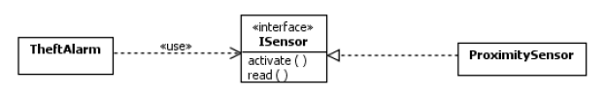
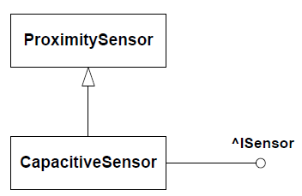
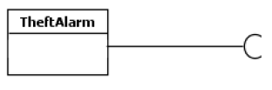
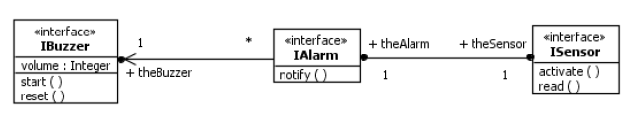


Slide 17
Summary
BehavioredClassifier : may have InterfaceRealizations, and owns a set of Behaviors one of which may specify the behavior of the BehavioredClassifier itself
DataType : is a type whose instances are identified only by their value
Enumeration : is a DataType whose values are enumerated in the model as EnumerationLiterals
EnumerationLiteral : is a user-defined data value for an Enumeration
Interfaces : declare coherent services that are implemented by BehavioredClassifiers that implement the Interfaces via InterfaceRealizations
InterfaceRealization : is a specialized realization relationship between a BehavioredClassifier and an Interface. This relationship signifies that the realizing BehavioredClassifier conforms to the contract specified by the Interface.

Slide 18
Summary
PrimitiveType : defines a predefined DataType, without any substructure
Reception : is a declaration stating that a Classifier is prepared to react to the receipt of a Signal.
Signal : is a specification of a kind of communication between objects in which a reaction is asynchronously triggered in the receiver without a reply

Slide 19
Structured Classifiers

Slide 20

?

Slide 21
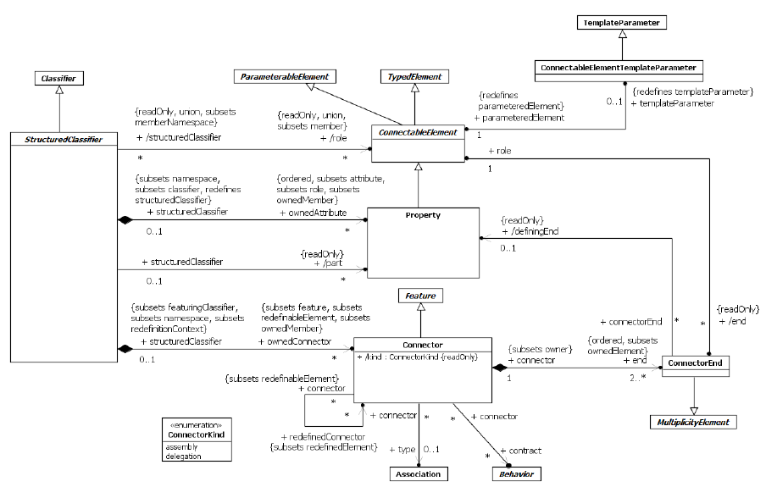
Structured Classifiers
StructuredClassifiers are Classifiers that may have an internal structure comprising a network of linked roles (which can themselves be instances of structured classifiers) and an external structure consisting of one or more Ports

Slide 22
Structured Classifiers
StructuredClassifiers may contain an internal structure of connected elements each of which plays a role in the overall behavior modeled by the StructuredClassifier
Connectable Elements :
ConnectableElement is an abstract metaclass
represents a participant within the internal structure of a StructuredClassifier
these participants are called roles
roles may be joined by Connectors
each ConnectableElement exhibits a set of effective required Interfaces and a set of effective provided Interfaces
The provided Interfaces comprises the union of the sets of Interfaces realized by the type of the ConnectableElement and its supertypes, or the set containing just its type if it is typed by an Interface.
The required Interfaces comprises the union of the sets of Interfaces used by the type of the ConnectableElement and its supertypes.

Slide 23
Structured Classifiers
Parts and Roles :
All of the ownedAttributes of a StructuredClassifier are roles and can be connected using Connectors.
Those ownedAttributes of a StructuredClassifier that have isComposite = true are called its parts. Hence parts constitute a subset of roles.
Connectors:
specifies links between two or more instances playing owned or inherited roles within a StructuredClassifier
Each Connector may be attached to two or more ConnectableElements, each representing a set of instances that contribute to the instantiation of the containing StructuredClassifier.
Links corresponding to Connectors may be created upon the creation of the instance of the containing StructuredClassifier. All such links are destroyed when the containing StructuredClassifier instance is destroyed
A Connector may be typed by an Association, in which case the links specified by the Connector are instances of the typing Association.
Each feature of each of the effective required Interfaces of each ConnectableElement at the end of a Connector must have at least one compatible feature among the features of the effective provided Interfaces of ConnectableElements at the other ends

Slide 24
Structured Classifiers
Connectors:
Connectors have a kind, whose value is assembly or delegation (related to ports)
Multiplicities and topologies :
The multiplicities on ConnectableElements constrain the number of objects that may be created within an instance of the containing StructuredClassifier
For a binary Connector, the ConnectorEnd’s multiplicity indicates the number of instances that may be linked to each instance of the ConnectableElement on the other end. For an n-ary Connector, the multiplicity of one end constrains the number of links that may refer to a set containing one particular instance for each of the other ends.
When an instance is removed from a role of an instance of a StructuredClassifier, links that exist due to Connectors between that role and others are destroyed.

Slide 25
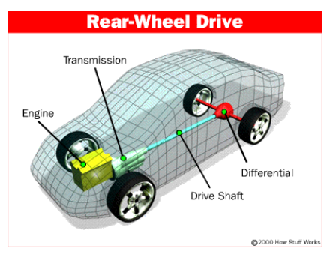
Structured Classifiers

Slide 26
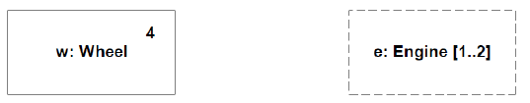

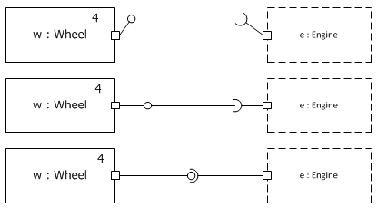
Structured Classifiers
isComposite=true
Part
Role
Port

Slide 27
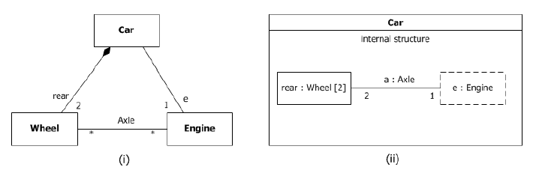
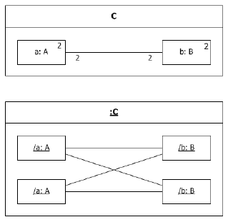
Structured Classifiers
The instances playing the e and rear roles may only be linked if they
are roles of the same instance of class Car.
Role Name
For each instance playing a role in an internal structure, there will initially be as many links as indicated by the lower
multiplicity of the opposite ends of Connectors attached to that role

Slide 28
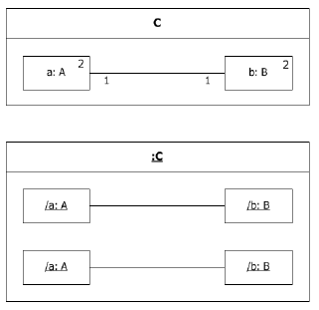
Structured Classifiers

Slide 29
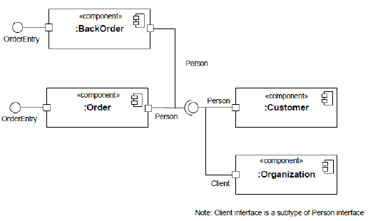
Structured Classifiers

Slide 30
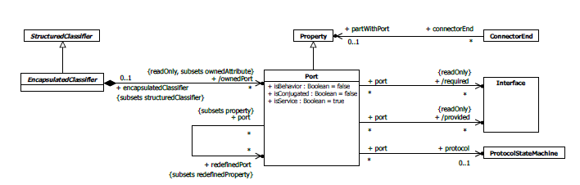
Encapsulated Classifier

Slide 31
Encapsulated Classifier
EncapsulatedClassifier extends StructuredClassifier with the ability to own Ports, a mechanism for isolating an EncapsulatedClassifier from its environment
Ports :
Ports represent interaction points through which an EncapsulatedClassifier communicates with its environment.
By decoupling the internals of the EncapsulatedClassifier from its environment, Ports allow an EncapsulatedClassifier to be defined independently of its environment, making it reusable in any environment.
A Port is a Property of an EncapsulatedClassifier that specifies a distinct interaction point between that EncapsulatedClassifier and its environment or between the Behavior of the EncapsulatedClassifier and its internal roles
Ports are connected by Connectors through which requests can be made to invoke the BehavioralFeatures of an EncapsulatedClassifier
A Port may specify the services an EncapsulatedClassifier provides (offers) to its environment as well as the services that an EncapsulatedClassifier expects (requires) of its environment

Slide 32
Encapsulated Classifier
Ports :
The property isService, when true, indicates that this Port is used to provide the published functionality of an EncapsulatedClassifier.
The required Interfaces of a Port characterize the requests that may be made from the EncapsulatedClassifier to its environment through this Port
The provided Interfaces of a Port characterize requests to the EncapsulatedClassifier that its environment may make through this Port
A Port has the ability, by setting the property isBehavior to true, to specify that any requests arriving at this Port are handled by the Behavior of the instance of the owning EncapsulatedClassifier, rather than being forwarded to any contained instances, if any. Such a Port is called a behavior Port
A delegation Connector is a Connector that links a Port to a role within the owning EncapsulatedClassifier ; It represents the forwarding of requests (Operation invocations and Signals); used to model the hierarchical decomposition of behavior, where services provided by an EncapsulatedClassifier may ultimately be realized by one that is nested multiple levels deep within it

Slide 33
Encapsulated Classifier
Ports :
As a ConnectableElement, the effective provided Interfaces (see 11.2.3) of a Port are its provided interfaces, and the effective required Interfaces are its required Interfaces. However, for a delegating Port, i.e., a Port that is at an end of a delegation Connector and is not on a role and that is not a behavior Port, the effective provided Interfaces are its required interfaces and its effective required Interfaces are its provided interfaces. Consequently a delegating Port behaves, for connection, as though it had an internal “face” that is the conjugate of its external “face.”
If several Connectors are attached on one side of a Port, then any request arriving at this Port on a link derived from a Connector on the other side of the Port will be forwarded on links corresponding to these Connectors.

Slide 34

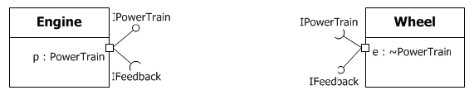
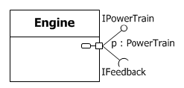

Slide 35
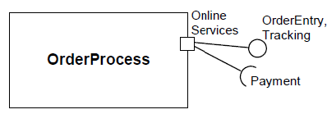
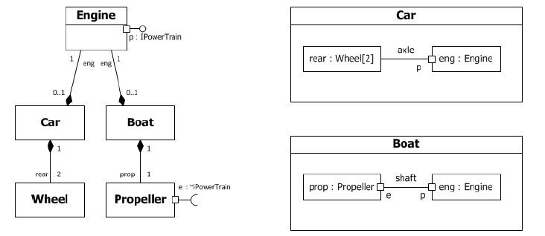

Slide 36
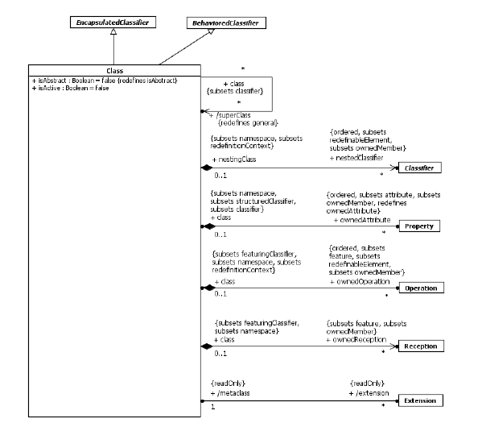
Classes
Classes : concrete realization of EncapsulatedClassifier and BehavioredClassifier.
The purpose of a Class is to specify a classification of objects and to specify the Features that characterize the structure and behavior of those objects.

Slide 37
Classes
Class is a kind of EncapsulatedClassifier whose Features are Properties, Operations, Receptions, Ports and Connectors
Attributes of a Class are Properties that are owned by the Class
Some of these attributes may represent the ends of binary Associations
Objects of a Class must contain values for each attribute that is a member of that Class, in accordance with the characteristics of the attribute, for example its type and multiplicity.
When an object is instantiated in a Class, for every attribute of the Class that has a specified default, if an initial value of the attribute is not specified explicitly for the instantiation, then the default ValueSpecification is evaluated to set the initial value of the attribute for the object.
Operations of a Class can be invoked on an object, given a particular set of values for the parameters of the Operation
A Class cannot access private Features of another Class, or protected Features on another Class that is not its ancestor
A Class acts as the namespace

Slide 38
Classes
An active object is an object that, as a direct consequence of its creation, commences to execute its classifierBehavior, and does not cease until either the complete Behavior is executed or the object is terminated by some external object. (This is sometimes referred to as “the object having its own thread of control.”) The points at which an active object responds to communications from other objects is determined solely by the Behavior of the active object and not by the invoking object. If the classifierBehavior of an active object completes, the object is terminated
A Class may be designated by setting isActive to true as active (i.e., each of its instances is an active object). When isActive is false the Class is passive (i.e., each of its instances executes within the context of some other object).
A Class’s Receptions specify which Signals the instances of this Class handle.
An InstanceSpecification may be used to specify the initial value to be created for a Class.
All instances corresponding to parts and ports of a Class are destroyed recursively, when an instance of that Class is deleted

Slide 39
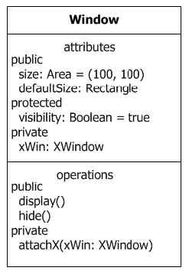
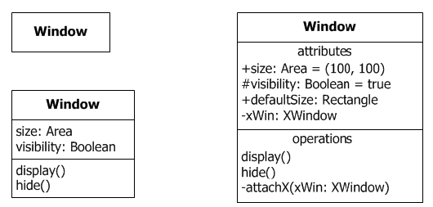

Active Class

Slide 40
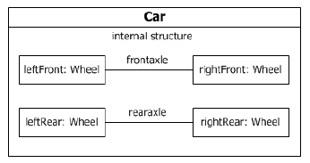
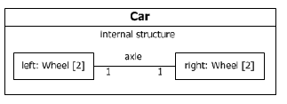

Slide 41
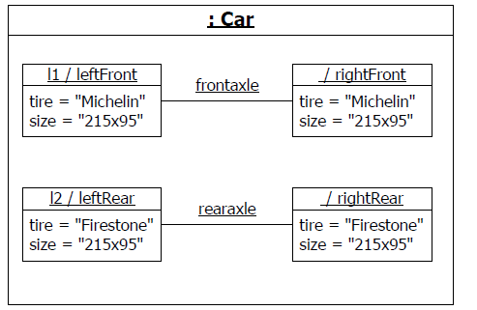

Slide 42
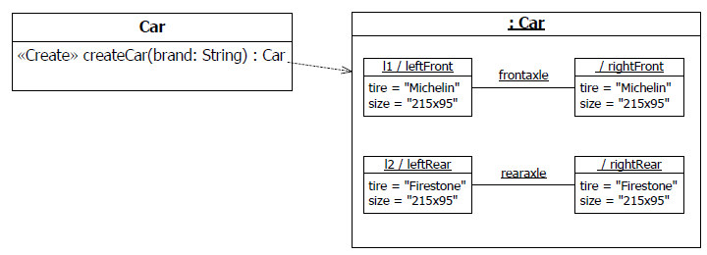

Slide 43
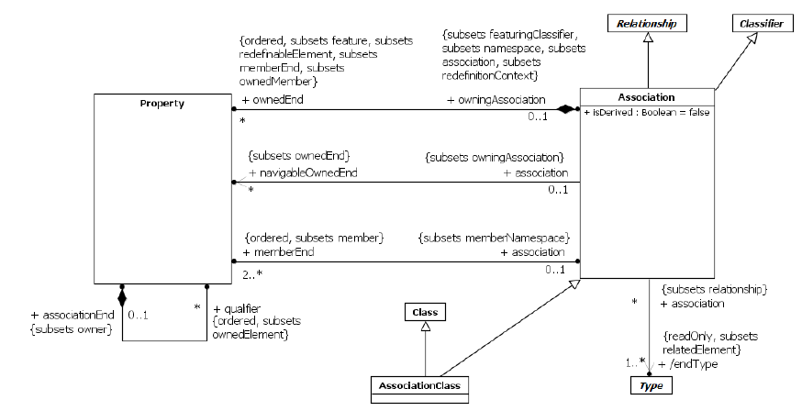
Association
An Association classifies a set of tuples representing links between typed instances.
An AssociationClass is both an Association and a Class.

Slide 44
An Association has at least two memberEnds
When one or more ends of the Association have isUnique=false, it is possible to have several links associating the same set of instances
A binary Association may represent a composite aggregation (i.e., a whole/part relationship). Composition is represented by the isComposite attribute on the part end of the Association being set to true.
Navigability means that instances participating in links at runtime (instances of an Association) can be accessed efficiently from instances at the other ends of the Association.
An AssociationClass is both an Association and a Class, and preserves the static and dynamic semantics of both

Slide 45
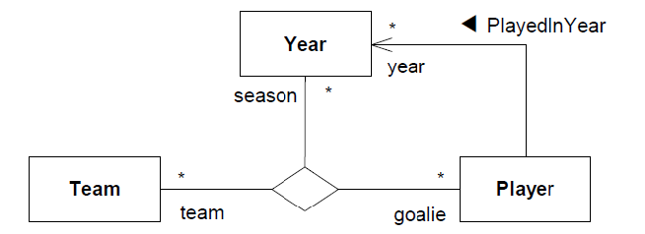

Slide 46
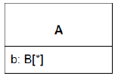
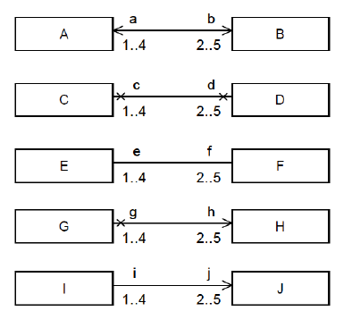
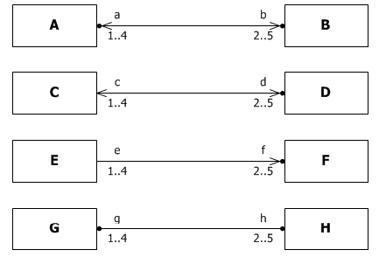

Slide 47
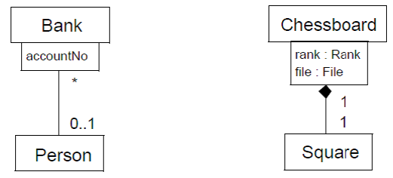
Qualified association

Slide 48
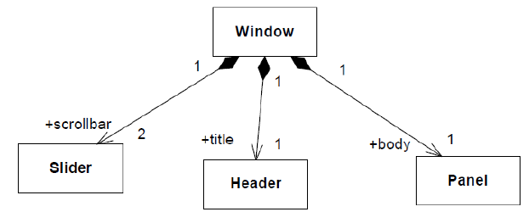
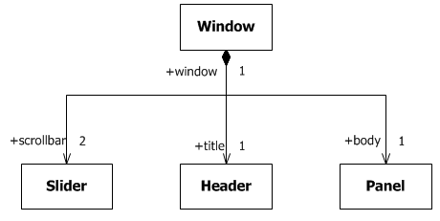

Slide 49
